Slide 1
Community Pharmacy Enhanced Service Networks (CPESN)
Christopher Daly, PharmD, MBA, BCACP Clinical Assistant Professor
University at Buffalo School of Pharmacy and Pharmaceutical Sciences
Christopher J Daly, PharmD, MBA
204 Kapoor Hall
cjdaly@buffalo.edu

Slide 2
Learning Objectives
Discuss common characteristics of pharmacies in a community pharmacy enhanced service network (CPESN).
Discuss the role of community pharmacy in providing medication management resources to the highest risk populations.
Describe how pharmacies are positioning themselves to integrate with care teams to lower health care costs and participate in new models of care and reimbursement.
Outline enhanced service networks participation criteria.
List examples of enhanced services.
Discuss key characteristics of clinically integrated networks.
Describe local CPESN network structure.
Identify strategic next steps for developing networks.

Slide 3
The world is changing around you, but you haven’t changed

Slide 4
Pharmacy Strategies for the Future?

Slide 5
The Future of Filling Prescriptions Fast, Accurate, and Cheap

Slide 6
Threats to Community Pharmacy
Notes:
In 2011, 7% of Medicare Part D plans included preferred pharmacy networks. 2 years later it was 50%. And, in 2018 that number is 99%. 772 out of 782 plans have preferred pharmacy networks.
And, the criteria to participate in preferred pharmacy networks have changed; they now include performance on key quality measures.
You need to gain and maintain access to preferred networks. Participating in preferred networks is necessary (even with the tradeoff of lower reimbursement) in order to have access to Medicare patients. Failure to participate in preferred networks will limit a pharmacy's access to Medicare beneficiaries in Part D plans. Because consumers generally have high satisfaction with their current pharmacy, pharmacies believe their customers will remain loyal. However, most Part D participants are likely to switch to in-network pharmacies. In fact, 85% of senior consumers say they would switch pharmacies to save even $10 or less on a co-pay.⁵ Maintaining participation in preferred networks requires constant vigilance of strong performance (in the top 20%) on key Star Ratings measures or other measures.

Slide 7
Positioned to go after the Medical Dollar
Notes:
The Healthcare Spending Pie: The Basis of CPESN USA’s Mission
In health care today, Pharmacy gets paid out of the $10 piece of the pie, while Medical costs (emergency department (ED) visits, hospitalizations, diagnostics, ambulance services, etc.) are paid within the $90 piece. As a pharmacist and staff member, you are working at the top of your licenses to identify and correct drug interactions, drug duplications, and non-adherence while providing disease state education. Everything that you do help to keep the patient healthy and out of the hospital and ED. All of your services provided affect the $90 piece, not the $10 piece. We are lowering the costs out of the $90 piece of the pie. The problem: There is total misalignment where we bring value as an enhanced services pharmacy. The current payment model has all of our payment coming from the $10 piece, but we bring value to the total healthcare system, which is within the $90 piece. The reason for becoming a CPESN pharmacy is to aggregate with other pharmacies who is providing the same type of services, which allows us to express where our real value is: the $90 piece of the pie.
We are not asking to pay us more within the $10 piece of the pie, but pay us different. Pay us from where we really add value to the system: the $90 piece of the pie.

Slide 8
Community Pharmacy Key Value Proposition: Leveraging Frequent “Touches”

Slide 9
Community Pharmacy Enhanced Services Networks (CPESN)
Enhanced Pharmacy Services - Services that transcend conventional requirements of an outpatient pharmacy program contract that are focused on improving clinical and global patient outcomes
Provide a venue to connect pharmacists and other pharmacy stakeholders who have interest in delivery of financially sustainable, patient-centered care beyond traditional dispensing services
Examples include, but are not limited to:
In-home delivery with patient status review
Medication synchronization with clinical review
Adherence packaging with patient coaching
Care management services

Slide 10
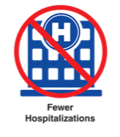
CPESN Pharmacies are Focused on More than just Filling Prescriptions
Provide medication optimization activities and enhanced services for patients
Collaborate with the extended care team to improve patient health
Focus on interventions that change patient behavior lead to better health
Notes:
All pharmacies are not the same. Some focus on the prescription and will continue down the “filling prescriptions as fast and accurate as you can” path.
Other pharmacies are different. They:
Can (or are willing to) provide medication optimization activities, patient care management, and other enhanced pharmacy services.
Collaborate with patient’s physicians and other care team members to improve the patient’s health,
Focus on the interventions that improve the health outcome of their patients. These are CPESN pharmacies.

Slide 11
NYCPS Newsletter Update May 2021
Notes:
The important update is that payer programs are being developed and exectued on.

Slide 12
Local, Community-Based Pharmacy
All pharmacies are not the same
Some pharmacies only focus on the prescription and filling it fast as they can… with little patient interaction
Other pharmacies focus on patients
These pharmacies have strong relationships with the patient and members of the patient’s local care team
These pharmacies provide enhanced services that have proven to improve the health of complex patients

Slide 13
Fee-For-Service versus Population Management

Slide 14
Population Analysis – Network Savings

Slide 16
Changing Pharmacy Market
Enhanced Service Pathway
“Commodity” Pathway
Quicker, cheaper, standard approach, less patient-focused
Patient Alignment:
As needed users
Less Risk
Lower Utilizers
Convenient, cost effective, customized approach, patient-focused care
Patient Alignment:
Frequent users
High ‘Risk’
High Utilizers

Slide 17
Purpose (Objectives) of Enhanced Service Networks
The purpose of the CPESN is to decrease costs to the healthcare system
Increasing low cost primary care utilization (e.g. primary prevention)
Offer services targeting chronic condition management, patient education and medication adherence
Maintain a network of community pharmacies that provide high quality ‘enhanced’ services
Increase collaboration with other healthcare providers, health systems, third party payers, accountable care organizations, and other stakeholders
Notes:
Purpose
The purpose of the CPESN of WNY is to develop, implement, and maintain a network of community pharmacies that provide high quality enhanced services to patients to improve patient clinical outcomes and utilization of healthcare resources by working collaboratively with other healthcare providers, health systems, accountable care organizations, and other key stakeholders. The CPESN of WNY will work with payers to ensure that overall health care spend is optimized and reduced by appropriately managing patients’ medication therapy. The network is focused on high quality performance in all aspects of the practice including implementation of enhanced services, provision of patient care services, collaboration with other health care providers and key stakeholders, and working closely with payers to improve overall health care resources utilization and overall health care spending. The participating CPESN of WNY pharmacies agree to be active participants in the network, collaborating and sharing ideas, and willing to share practice data as determined, requested, and needed by the network.

Slide 18
Current Issues to Enhanced Service Network
How to scale team-based medication optimization efforts?
How do you change the workflow of a community pharmacy?
How do you evolve payment systems (e.g. – sell quality)?
How do you establish a network while maintaining autonomy?
Who will establish an equitable referral system?
What standards will be set and how to you evaluate quality?
Others issues?
(Begin to think about how this will get done)

Slide 19
Characteristics of the Enhanced Service Networks
Establish a therapeutic relationship with patients
Offer a confidential setting to talk with patients about their medications and other concerns
Assist the patients with understanding the importance of all medications and taking them as prescribed or recommended
Access to medication reviews on an ongoing basis
Work collaboratively with health care professionals to identify and resolve drug therapy problems (DTPs)
Provide care coordination for patients between provider office visits
Notes:
Establish a therapeutic relationship with patients
Offer a private and confidential setting to talk with patients about their medications and related health care issues or concerns;
Counsel patients on the appropriate and safe use of their medications (prescription, OTC, supplements, herbals and home remedies) including benefits and potential side effects;
Assist the patients with understanding the importance of all medications and taking them as prescribed or recommended;
Provide regular ongoing reviews of patients’ medication regimens to identify opportunities to optimize therapy;
Work collaboratively with health care professionals to resolve any concerns with the patients’ medications;
Reinforce the patients’ goals of therapy;
Enhance care coordination and provide additional monitoring between provider office visits for patients, especially those who are non-‐adherent to medications and/or are medically complex; and
Communicate with prescribers and other providers that provide clinical recommendations to resolve DTPs, achieve goals of therapy, and improve patient outcomes.

Slide 20
Enhanced Service Networks Participation Criteria
Pharmacy Roles and Responsibilities
Current registration with state BOP in good standing
Current pharmacy provider of “X” stakeholder (e.g. – NYS Medicaid – DSRIP)
A signed agreements (network standards) with ESN and (1) local network, (2) national network, (3) stakeholder
Agreement to provide a minimum set of enhanced services (typically includes):
Patient counseling and adherence coaching (e.g. – MTM, CMR, Med Sync)
Assistance with medication reconciliation (e.g. – PMR)
Disease state management (e.g. – Immunizations, Weight Loss, Tobacco Cessation)
Logistical (e.g. – home delivery (free))

Slide 21
Enhanced Service Networks Participation Criteria – Continued
Pharmacy Roles and Responsibilities
Maintain attendance at program continuation education events
Be active member of established workgroups (e.g. – Service Set, Quality Assurance & Performance Measures, Network Communications & Technical Operations)
Pharmacies must respect and uphold patient privacy standards as designed by state and federal HIPAA regulations
Maintain clinical standards (per contract, network)
Respect each patient’s right to choose their own practitioners and pharmacies

Slide 22
Enhanced Services
Enhanced Pharmacy Services - Services that transcend conventional requirements of an outpatient pharmacy program contract that are focused on improving clinical and global patient outcomes
Examples include, but are not limited to:
In-home delivery with patient status review
Medication synchronization with clinical review
Adherence packaging with patient coaching
Care management services

Slide 23
Enhanced Service - Gain profit
A typical independent pharmacy generates over 90% of revenue from prescriptions.
Average profit per prescription is $11.99
Gross margins for Rx medications have declined
Community-based pharmacy should consider gaining profit by implementing enhanced pharmacy service.
Enrolling complex patients in a medication adherence program can benefit community pharmacies, particularly CPESN pharmacies, through chronic medication fills and yearly profit.
Notes:
Reference: Clifton, Cody L., et al. "Financial impact of patients enrolled in a medication adherence program at an independent community pharmacy."Journal of the American Pharmacists Association58.4 (2018): S109-S113.

Slide 24
Types of Enhanced Services*
24 Hour Emergency Services
Adherence Packaging
Collection of Vital Signs
Compounding
Comprehensive Medication Review
Home Delivery
Home Visits
Long-Acting Injections
Med Synchronization Program
Multi-Lingual Capability
Naloxone Dispensing
Nutritional counseling
Point of Care Testing
Smoking Cessation
Standardized Assessments (PHQ-9)
Disease State Management Programs
*Not done at every pharmacy, scope of practice laws come into play.

Slide 25
Identifying Ideal Patients for Local, Community-Based Pharmacy

Slide 26
Enhanced Services – Financial Model
Past Model
Type: FFS
Parameters:
Enhanced Service Model
Type: FFS ( Minus DIR fees), VBP
Parameters:
750 patients, 6 Rx’s/month = 54,000 Rx’s/year
$10 (average gross/Rx) = $540,000 Gross
750 patients + 150 referred to ESN (8 Rx’s month) = 54,000 + 14,400 = 68,400 Rx’s/year
Dispensing (750) $540,000 – (DIR fee: $50,000) = $490,000
$20 Per Member Per Month * 12 months * 150 patients = $36,000
Dispensing (150) $144,000 – (DIR fee: $10,000) = $134,000
$490,000 + $134,000 + $36,000 = $660,000

Slide 27
Characteristics of Clinically Integrated Networks (CIN)
CIN a collection of health care providers that demonstrates value to the market by working together to facilitate the coordination of patient care across conditions, providers, and settings to improve patient care and decrease overall healthcare costs.
A CIN of pharmacists can engage with payers to contract for shared dollars that payers save in patient care costs as a result of set services.
The CIN maintains local structure by engaging in the following: deliver baseline high quality valued services, develop communication with patients and HCP, augment care teams, establish and maintain performance standards.

Slide 28
Clinically Integrated Network of Pharmacy Providers
Pharmacy Benefit
Payer
Payment Leverage
Lower Blood Pressure
Fewer ER Visits

Slide 29
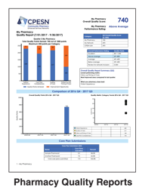
Keys to a Clinically Integrated Network
Prospective and
Retrospective Quality Data

Slide 30
Local CPESN Network Structure CPESN Launch Plan
Phase 1: Determining Interest
Introduce CPESN Concept (Webinars, Live Meeting Presentation, One-on-One Discussions)
Identify Voluntary Work Group Participants/Advisory Board Members
Phase 2: Develop Network Framework
Work Group Leads Determine Luminaries (spokespersons and workgroup leads) Set Workgroup Schedule
Develop Excel List of Interested Participating Pharmacies Determine Name of your CPESN (e.g. CCNC CPESN) Finalize Required and Optional service sets
Finalize Inclusion Principles and Roles & Responsibilities of Participating Pharmacies Determine how Decisions are Made (e.g. by democratic vote by each physical location) Finalize Letter of Commitment
Engage Schools of Pharmacy on Student Immersion Engage other Potential Partnerships

Slide 31
Local CPESN Network Structure CPESN Launch Plan
Phase 3: Preparing to Launch
Identify Network Administrator (Find/Fund/Borrow)
Establish Participation Agreement
Note: Legal agreement will need to be in place in circumstances where data sharing/exchange occurs.
Survey participants to determine enhanced services offerings
Establish Branding: Develop CPESN Logo
Develop Map/Collaboration Card Demo Pharmacy Locator Application
Develop Outreach Plan to Providers, ACOs, Health System Develop Communication Strategy for CPESN Participant Outreach
Phase 4: Network Launched
Participate in local and USA activities to grow network while seeking initial opportunities

Slide 32
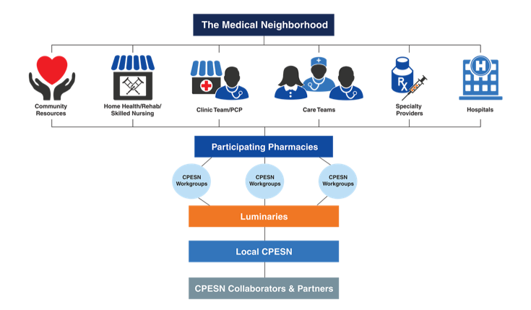
Local CPESN Network Structure

Slide 33
National Scan of Emerging CPESN USA Networks

Slide 34
Fall 2016 CPESN USA – Network(s) Status

Slide 35
Fall 2017 CPESN USA – Network(s) Status

Slide 36
Spring 2018 - CPESN USA – Network(s) Status

Slide 37
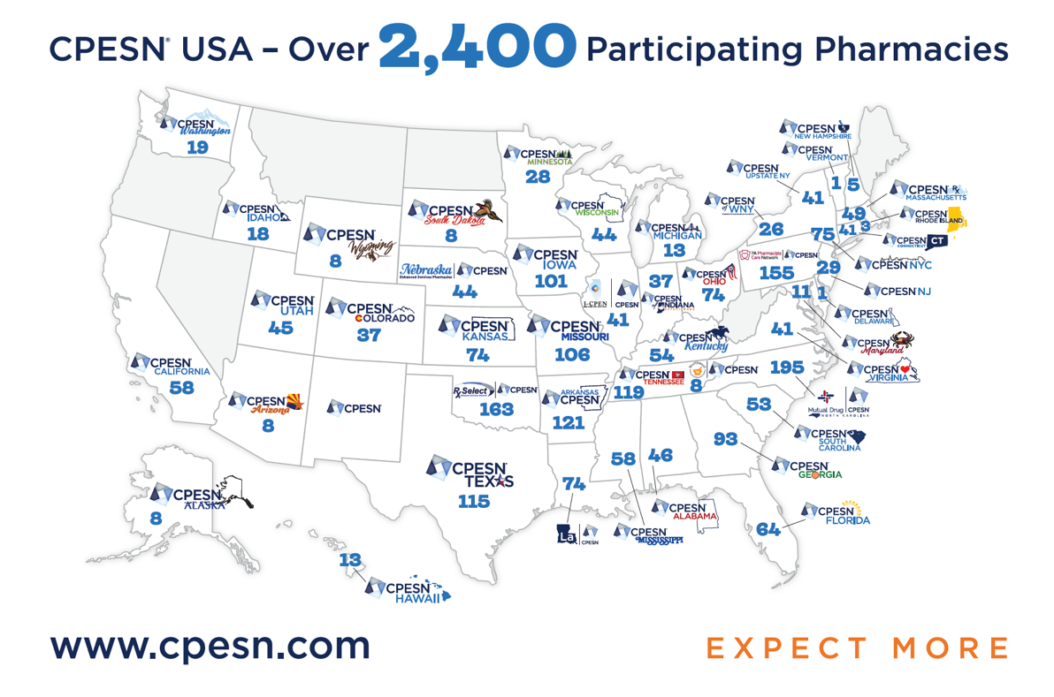
Fall 2019 - Local CPESN Networks Across America

Slide 38
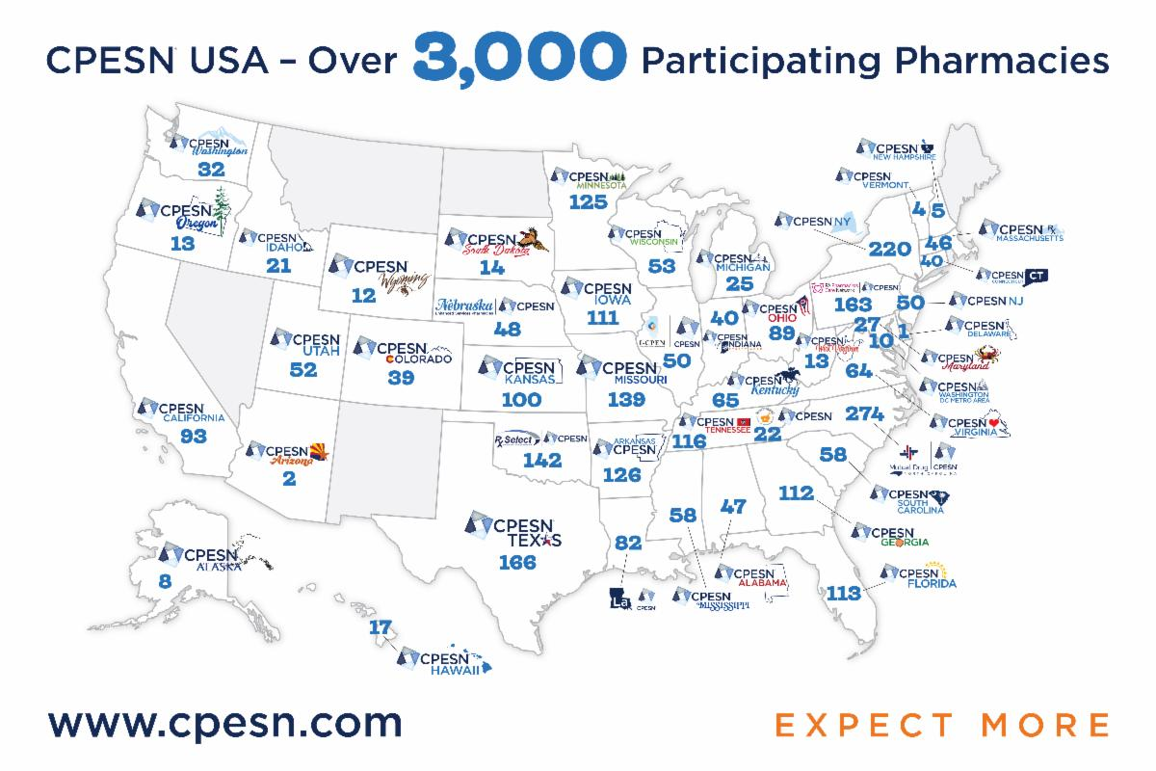
Fall 2020 - Local CPESN Networks Across America

Slide 39
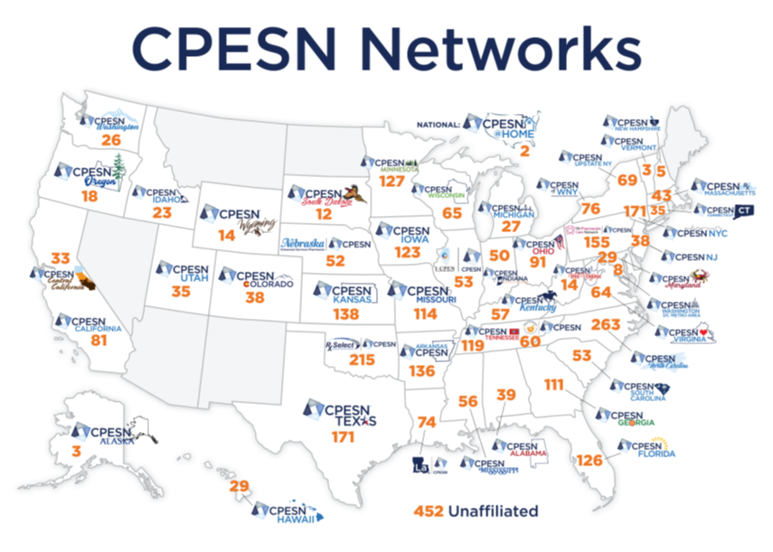
Fall 2021 - CPESN Networks Across America
Map of Networks
Current map local network logos.
>3,400 participating pharmacies and 44 states. Total of 316 pharmacies in New York (CPESN NY) with North Carolina (Mutual CPESN) having 263.

Slide 40
What does New York’s CPESNs look like?
CPESN Networks in New York State
Notes:
Breakdown regions, numbers in each, each network at different stages

Slide 41
Academia-CPESN
The ACT (Academia-CPESN Transformation) Pharmacy Collaborative is an operational learning and ACTing collaborative between schools of pharmacy and established clinically integrated networks of community-based pharmacies.
UB joins the Academia-CPESN Transformation Pharmacy Collaborative in 2019.
Notes:
For more information: http://www.buffalo.edu/tprc/news-and-announcements.host.html/content/shared/pharmacy/articles/academic_articles/2019/ub-joins-the-academia-cpesn-transformation-pharmacy-collaborative.detail.html
https://www.actforpharmacy.co

Slide 42
CPESN / ACT – Synergy
CPESN
ACT
CPESN:
Pharmacy networks working to bring about
network development, quality,
payer engagements
ACT:
Learners, faculty come together to promote
student engagement, curriculum development,
research
Synergy:
Collaborative projects, student rotations (ACPHS Examples)
grants, practice transformation (Flip the Pharmacy), innovation
Notes:
ACT Pharmacy Collaborative Goal
Support the transformation of community-based pharmacy practice from a product-based care model to a community-based pharmacy care delivery model
PURPOSE:
To establish successful partnerships between colleges/schools of pharmacy and community-based clinically integrated networks. By participating in the Collaborative, we will share our expertise and will learn from the experts who have had success in building these partnerships within their states or regions.
Involvement to date:
Some schools engaged need more.

Slide 43
Long Term Plan
Launch many Enhanced Service Networks
NYS (Currently 3 active): NYC, Upstate, and WNY
Explore opportunities for collaboration with value purchasers
Establish patient referral patterns to network pharmacies
Leverage clinical activities performed by community pharmacies to mitigate risk against narrow networking or reimbursement reductions on product distribution
Establish relationships and reimbursement models with medical benefit side of payer infrastructure

Slide 44
Current Issues to Enhanced Service Network
How to scale team-based medication optimization efforts?
How do you change the workflow of a community pharmacy?
How do you evolve payment systems (e.g. – sell quality)?
How do you establish a network while maintaining autonomy?
Who will establish an equitable referral system?
What standards will be set and how to you evaluate quality?
Others issues?

Slide 45
Current Issues to Enhanced Service Networks
How to scale team-based medication optimization efforts?
Increase technician role, technology, others?
How do you change the workflow of a community pharmacy?
Add automation, sync all chronic care patients, others?
How do you evolve payment systems (e.g. – sell quality)?
Get into smaller contracts to prove worth, go after medical outcomes [examples]
How do you establish a network while maintaining autonomy?
Clinically integrated networks, creating legal structure
Who will establish an equitable referral system?
Workgroups within CPESN local networks
What standards will be set and how to you evaluate quality?
CPESN local Network Standards

